Slide 1




Unit 1
My Friends
MsPham
0936082789
MsPham
0936082789
Lesson 1 – Period 1

Slide 2

WARM UP

Slide 3

Watch to the video.
What countries do you see?

Slide 4

2. Memory.
Tick the name of countries you can see.
Vietnam
Germany
America
Canada
Korea
Britain
Russia
Australia

Slide 5
2. Let’s check.
How many countries are you right?

Slide 6

Vocabulary
MsPham
0936082789

Slide 7

Vocabulary
Britain
/ˈbrɪtn/
MsPham
0936082789
Nước Anh

Slide 8

Vocabulary
Vietnam
/ˌviːetˈnɑːm/
MsPham
0936082789
Nước Việt Nam

Slide 9

Vocabulary
America
/əˈmerɪkə/
MsPham
0936082789
Nước Mĩ

Slide 10

Vocabulary
Australia
/ɒˈstreɪliə/
MsPham
0936082789
Nước Úc

Slide 11

Vocabulary
Vietnam
/ˌviːetˈnɑːm/
: Nước Việt Nam
MsPham
0936082789
America
/əˈmerɪkə/
: Nước Mĩ
Britain
/ˈbrɪtn/
: Nước Anh
Australia
/ɒˈstreɪliə/
: Nước Úc

Slide 12
Look, read and match
1
a
Vietnam
2
b
America
3
c
Australia
4
d
Britain

Slide 13
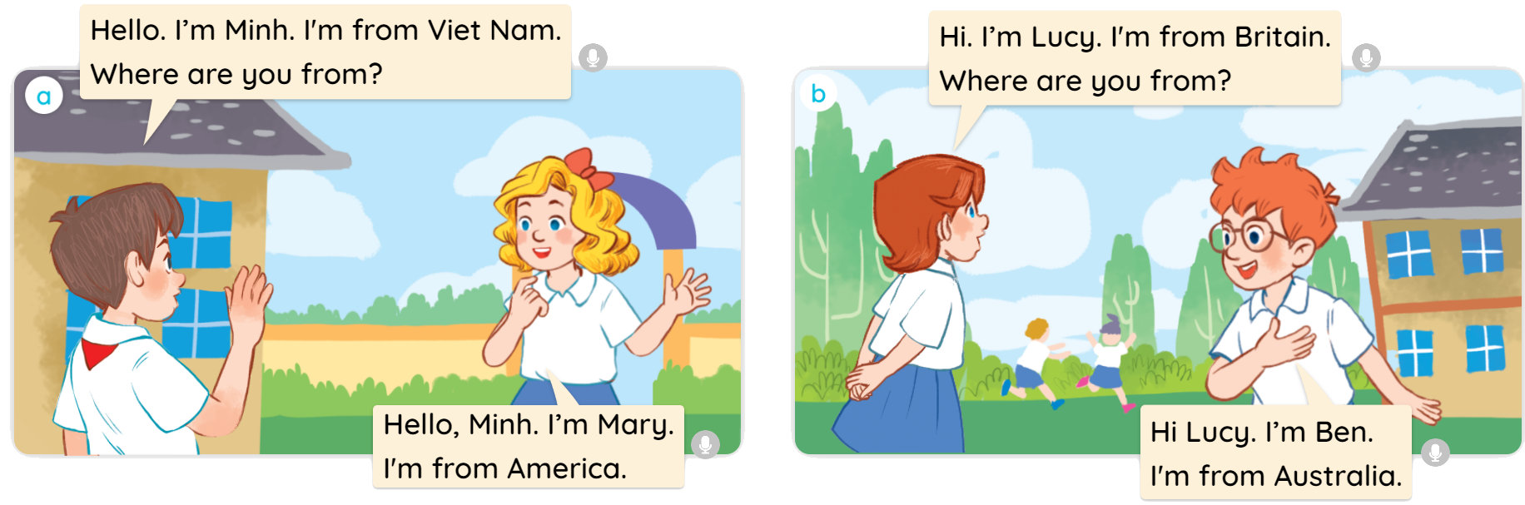


1
Look, listen and read.

Slide 14
Structure
MsPham
0936082789

Slide 15



1
Cách hỏi bạn đến từ đâu
Where are you from?
(Bạn đến từ đâu?)
I’m from ________.
(Tớ đến từ ______.)
Note:
I am = I’m
Ex:
Where are you from?
I’m from Vietnam.
MsPham
0936082789

Slide 16




2
Listen, point and say.
Where are you from?
I’m from _________.
a
b
Britain
Vietnam
a
b
America
Australia

Slide 17


2
Listen, point and say.
a
MsPham
0936082789
Britain
Where are you from?
I’m from Britain.

Slide 18
2
Listen, point and say.
b
MsPham
0936082789
Vietnam
Where are you from?
I’m from Vietnam.

Slide 19

2
Listen, point and say.
c
MsPham
0936082789
America
Where are you from?
I’m from America.

Slide 20
2
Listen, point and say.
d
MsPham
0936082789
America
Where are you from?
I’m from America.

Slide 21
2
Listen, point and say.
Where are you from?
I’m from _________.
a
b
Britain
Vietnam
a
b
America
Australia

Slide 22








FEEDING GOLDFISH
Mỗi câu trả lời đúng là
CÂU THẦN CHÚ giúp cá Vàng
ngoi lên mặt nước nhận thức ăn.
Nào chúng mình cùng giúp
bạn nhỏ cho cá Vàng ăn nhé!
START

Slide 23

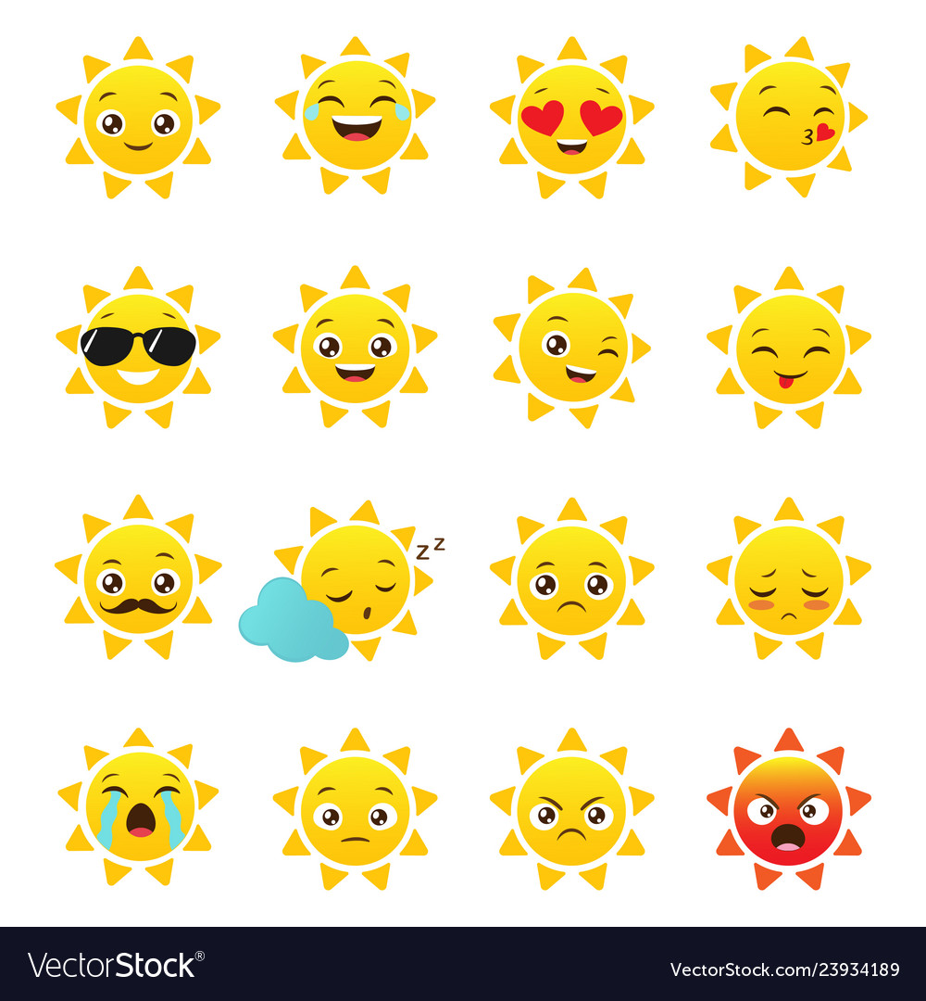
Where are you from?
I'm from ________.
Next
Australia
Vietnam
Britain
Notes:
YOUTUBE: MsPham.
Facebook: Dạy và học cùng công nghệ.

Slide 24
Where are you from?
I'm from ________.
Next
Britain
America
Australia
Notes:
YOUTUBE: MsPham.
Facebook: Dạy và học cùng công nghệ.

Slide 25
Where are you from?
I'm from ________.
Next
Australia
America
Vietnam
Notes:
YOUTUBE: MsPham.
Facebook: Dạy và học cùng công nghệ.

Slide 26
Where are you from?
I'm from ________.
Next
Britain
Vietnam
America
Notes:
YOUTUBE: MsPham.
Facebook: Dạy và học cùng công nghệ.

Slide 27

Where are you from?
I'm from ________.
Next
America
VietNam
Australia
Notes:
YOUTUBE: MsPham.
Facebook: Dạy và học cùng công nghệ.

Slide 28
Where are you from?
I'm from ________.
Next
Britain
Australia
America
Notes:
YOUTUBE: MsPham.
Facebook: Dạy và học cùng công nghệ.

Slide 29
Where are you from?
I'm from ________.
Next
Australia
VietNam
Britain
Notes:
YOUTUBE: MsPham.
Facebook: Dạy và học cùng công nghệ.

Slide 30
Where are you from?
I'm from ________.
Next
America
Britain
VietNam
Notes:
YOUTUBE: MsPham.
Facebook: Dạy và học cùng công nghệ.

Slide 31
THANK YOU!
Next
Notes:
YOUTUBE: MsPham.
Facebook: Dạy và học cùng công nghệ.

Slide 32





2
Let’s talk.
Where are you from?
I’m from Vietnam.
I’m from Australia.
I’m from America.
I’m from Britain.

Slide 33
Review

Slide 34


Where are you from?
(Bạn đến từ đâu?)
MsPham
0936082789
I’m from _________.
(Tớ đến từ ____)
I am = I’m
Vietnam
MsPham
0936082789
Australia
America
Britain

Slide 35
MsPham Powerpoint
Thank you
Mspham
MsPham
0936082789
For joining!

