Slide 1





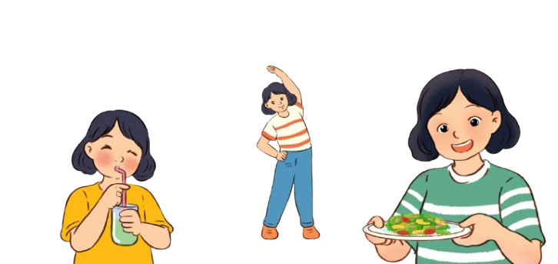
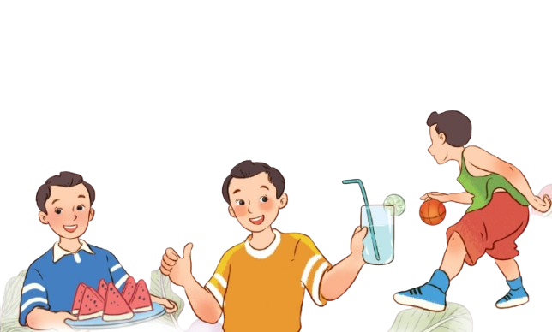
Unit 14
Staying healthy
Lesson 1 – part 1, 2, 3

Slide 2

Table of contents
01.
Warm-up
02.
Look, listen and repeat
03.
Listen, point and say
04.
Let’s talk
05.
Fun corner and wrap-up

Slide 3

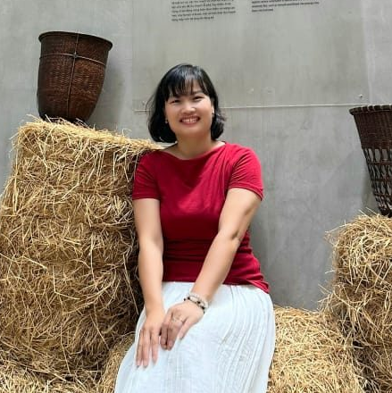
1
Warm-up
Ms.Pham
0936082789
Ms.Liên
0984090525

Slide 4
2
Look, listen
and repeat
Ms.Pham
0936082789
Ms.Liên
0984090525

Slide 5
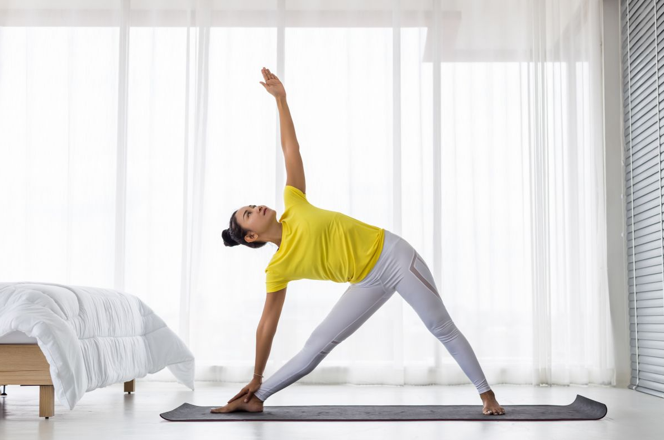
Vocabulary
do morning exercise
/duː ˈmɔːnɪŋ ˈeksəsaɪz/
MsPham
0936082789
Tập thể dục
buổi sáng
https://www.facebook.com/msphampowerpoint

Slide 6
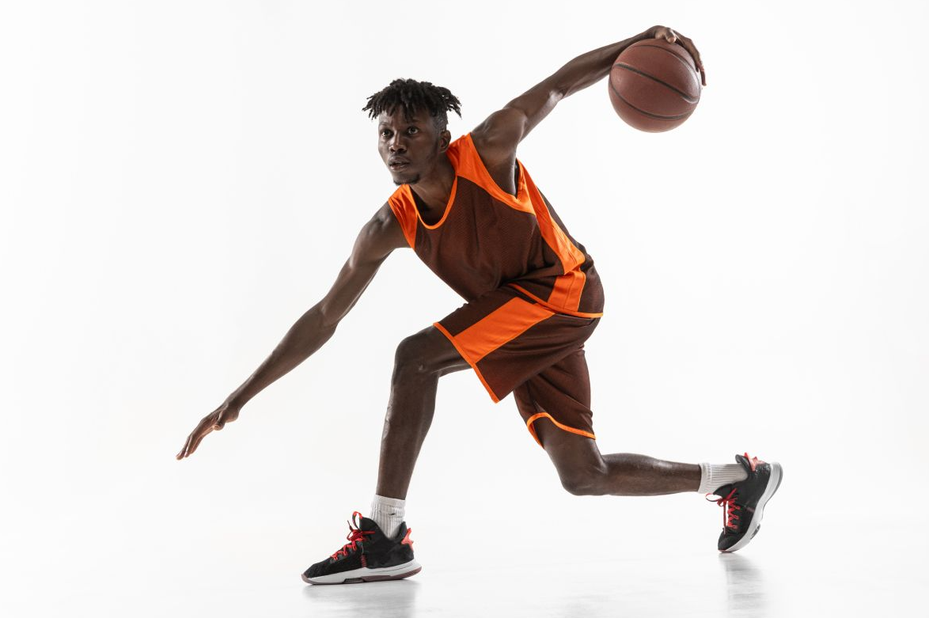
Vocabulary
play sports
/ˌpleɪ ˈspɔːts/
MsPham
0936082789
Chơi thể thao
https://www.facebook.com/msphampowerpoint

Slide 7
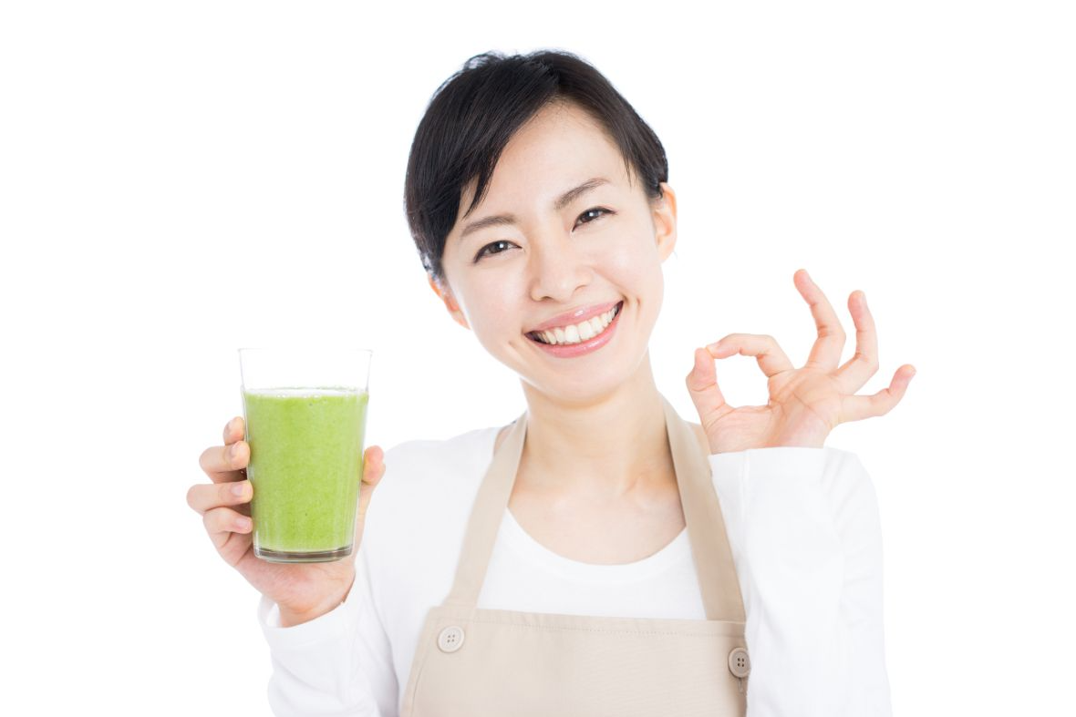
Vocabulary
drink fresh juice
/ drɪŋk freʃ dʒuːs/
MsPham
0936082789
Uống nước ép tươi
https://www.facebook.com/msphampowerpoint

Slide 8
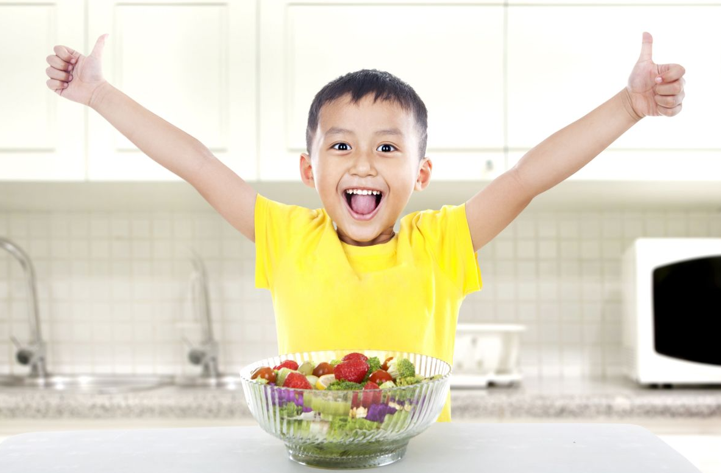
Vocabulary
eat healthy food
/iːt ˈhelθi fuːd/
MsPham
0936082789
Ăn thức ăn tốt
cho sức khỏe
https://www.facebook.com/msphampowerpoint

Slide 9
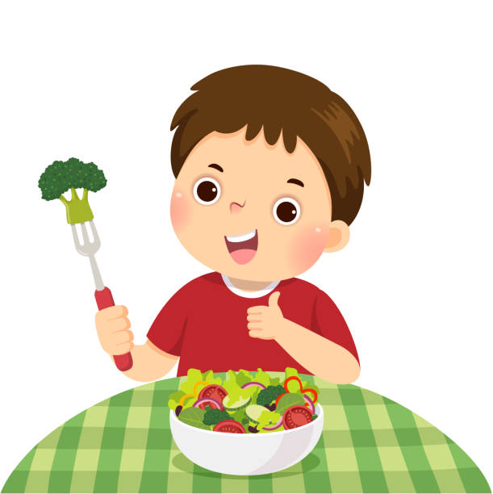
Vocabulary
eat vegetables
/ iːt ˈvedʒtəbls/
MsPham
0936082789
Ăn rau
https://www.facebook.com/msphampowerpoint

Slide 10
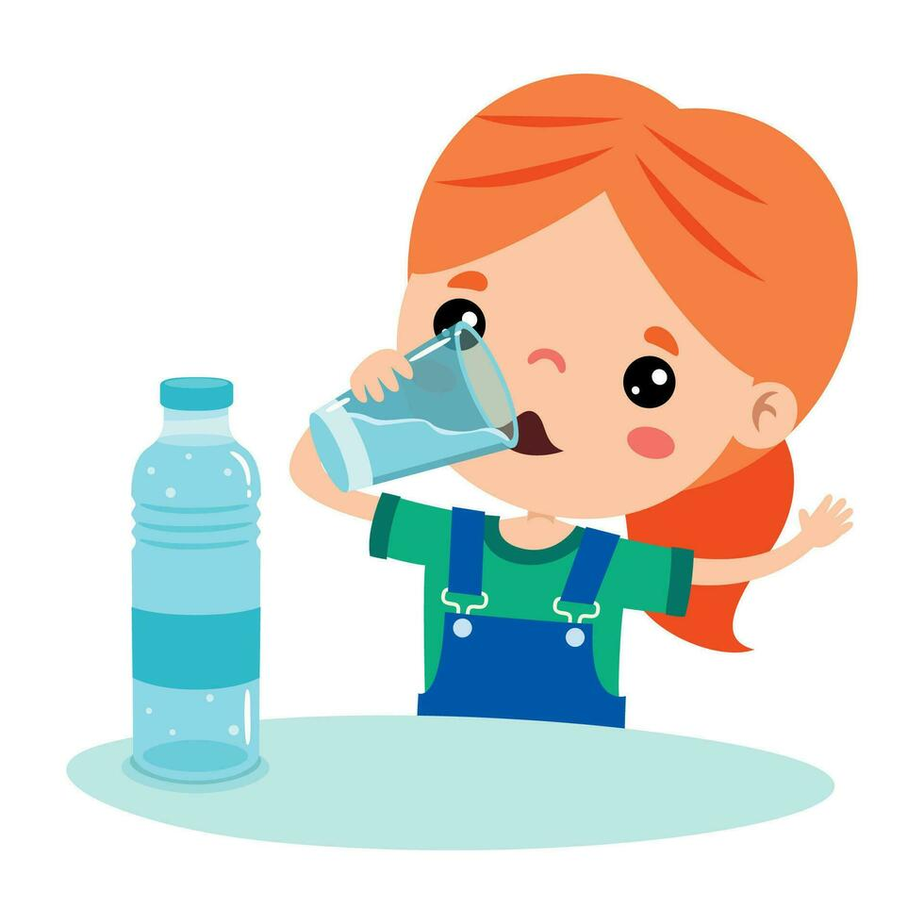
Vocabulary
drink a lot of water
/drɪŋk ə lɒt əv wɔːtər/
MsPham
0936082789
Uống nhiều nước
https://www.facebook.com/msphampowerpoint

Slide 11
Vocabulary
stay healthy
/steɪ ˈhelθi/
MsPham
0936082789
Giữ gìn sức khỏe
https://www.facebook.com/msphampowerpoint

Slide 12
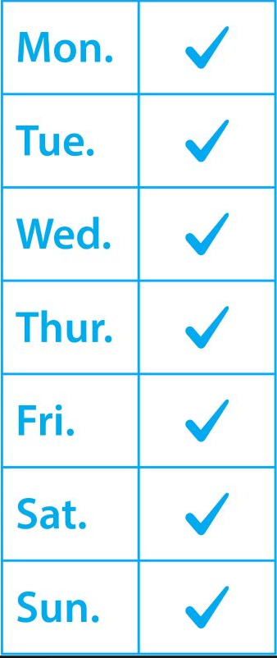
Vocabulary
every day
/ˈevri deɪ/
MsPham
0936082789
Mỗi ngày
https://www.facebook.com/msphampowerpoint

Slide 13
Vocabulary
do morning exercise
drink a lot of water
every day
stay healthy
drink fresh juice
play sports
eat healthy food
eat vegetables

Slide 14



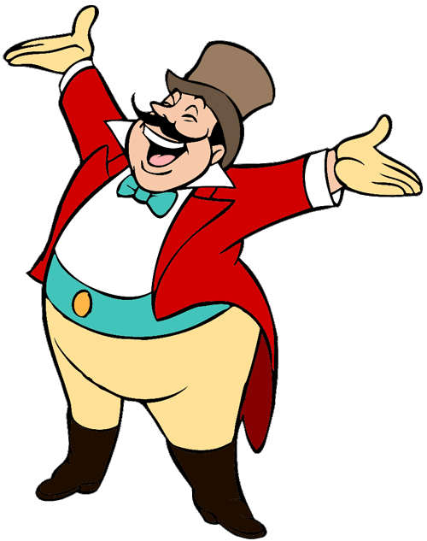
START

Slide 15




Listen and choose the best answer:
MsPham
0936082789
MsPham
0936082789
eat vegetables
every day
drink a lot of water

Slide 16
Listen and choose the best answer:
MsPham
0936082789
every day
stay healthy
drink fresh juice
Next

Slide 17
Listen and choose the best answer:
MsPham
0936082789
MsPham
0936082789
stay healthy
eat vegetables
drink fresh juice

Slide 18
stay healthy
Listen and choose the best answer:
MsPham
0936082789
stay healthy
drink fresh juice
do morning exercise
Next

Slide 19
Listen and choose the best answer:
MsPham
0936082789
do morning exercise
eat healthy food
drink fresh juice

Slide 20
Listen and choose the best answer:
MsPham
0936082789
MsPham
0936082789
drink a lot of water
do morning exercise
every day

Slide 21
Listen and choose the best answer:
MsPham
0936082789
drink fresh juice
eat healthy food
play sports

Slide 22
Listen and choose the best answer:
MsPham
0936082789
play sports
eat healthy food
eat vegetables
Next

Slide 23





Slide 24
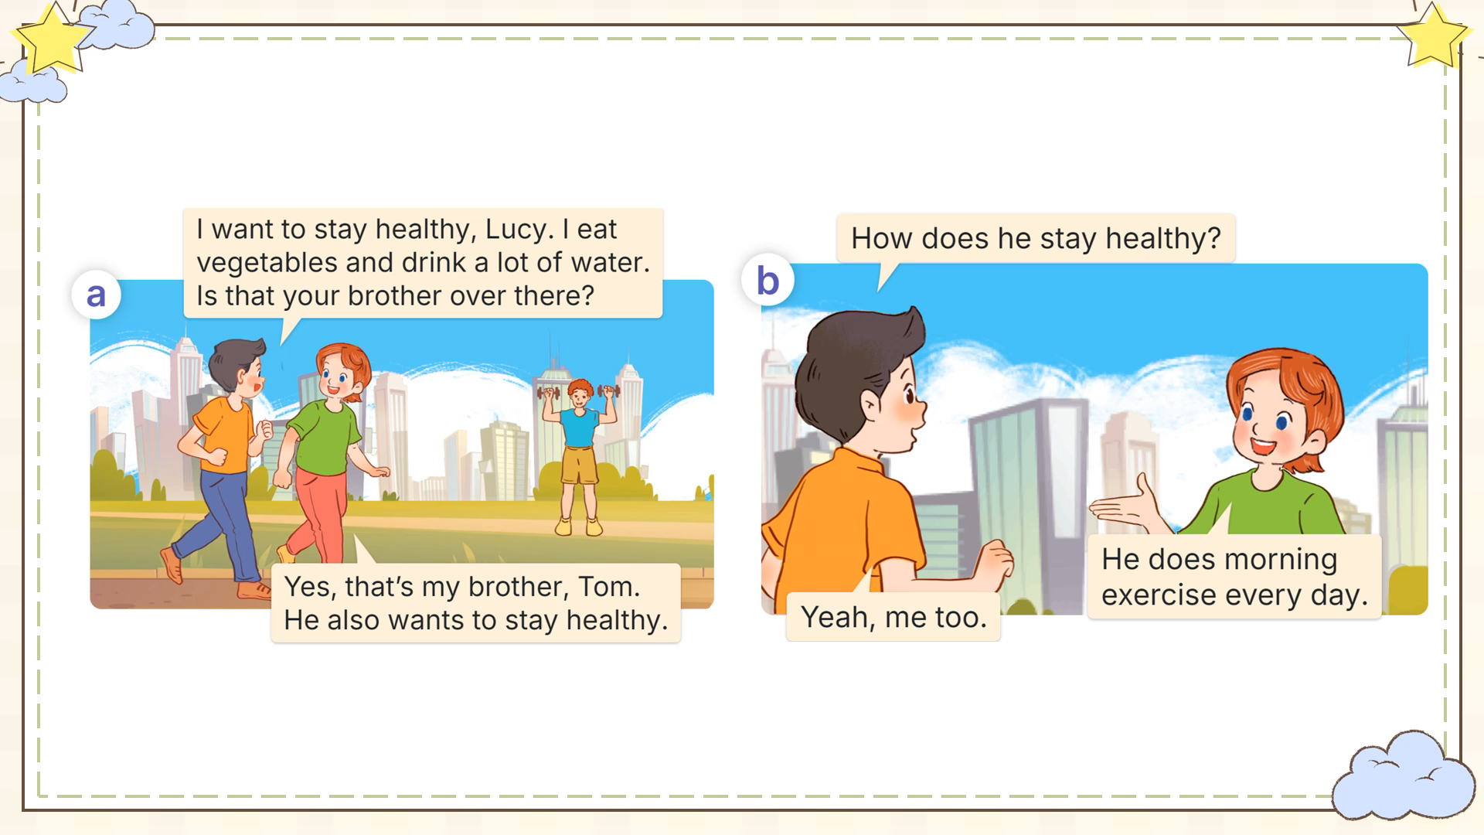
Look and listen
MsPham
0936082789

Slide 25
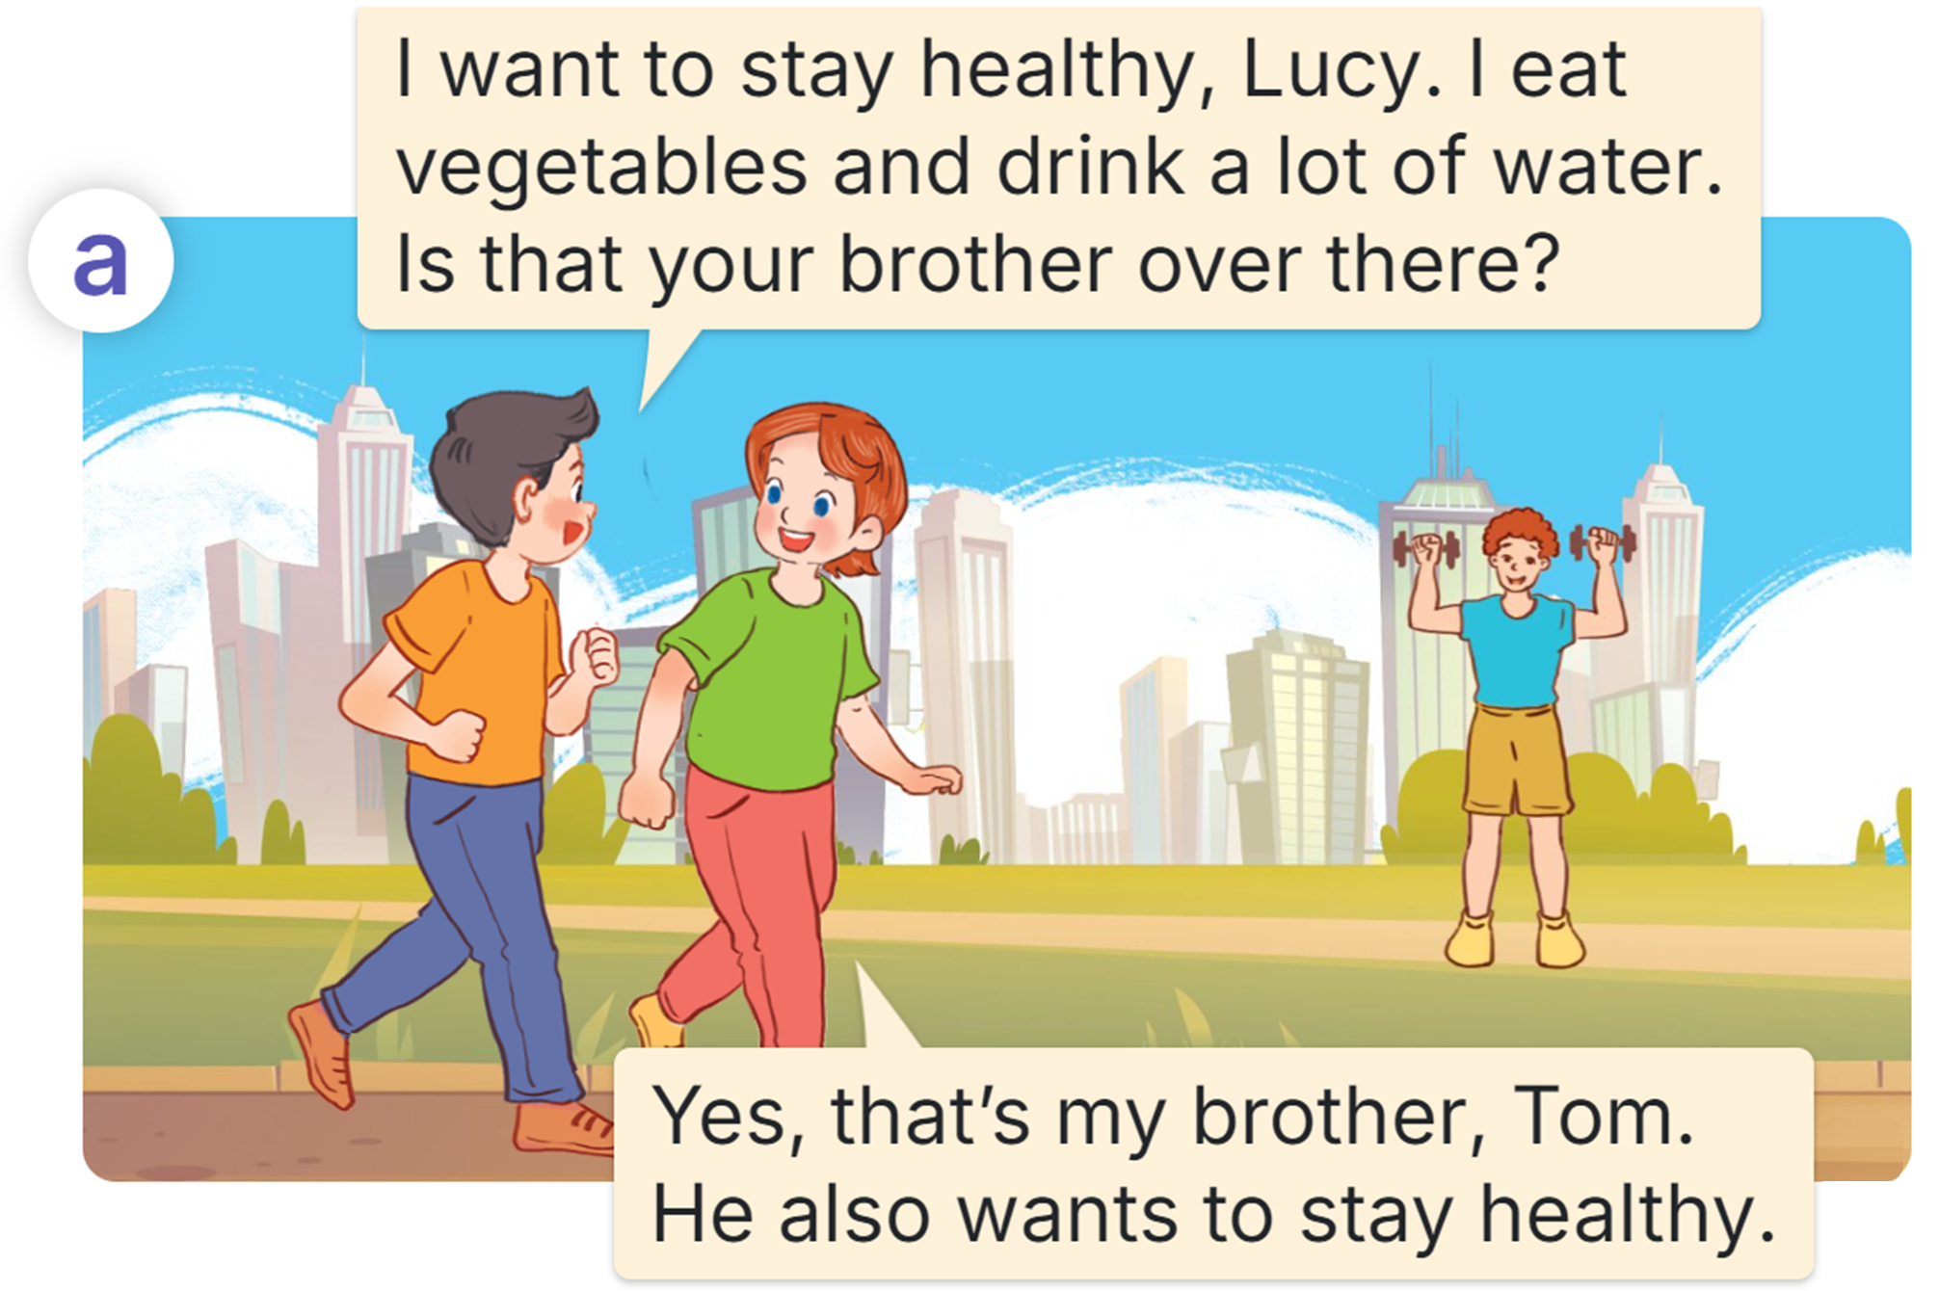
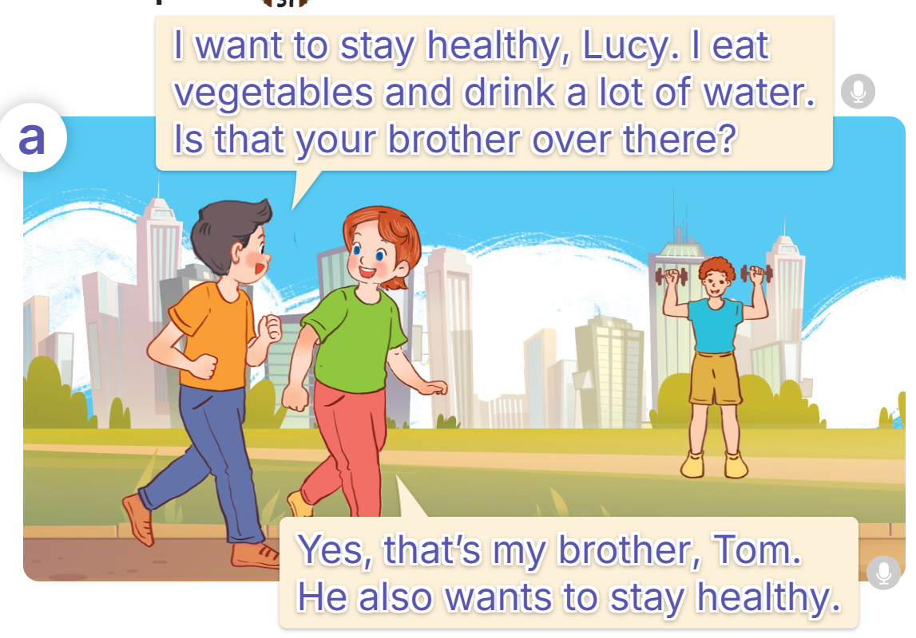
Listen and read
MsPham
0936082789

Slide 26
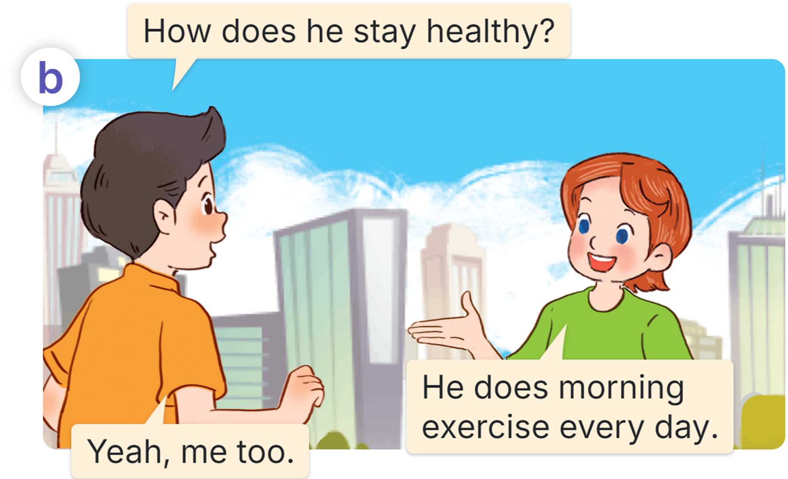
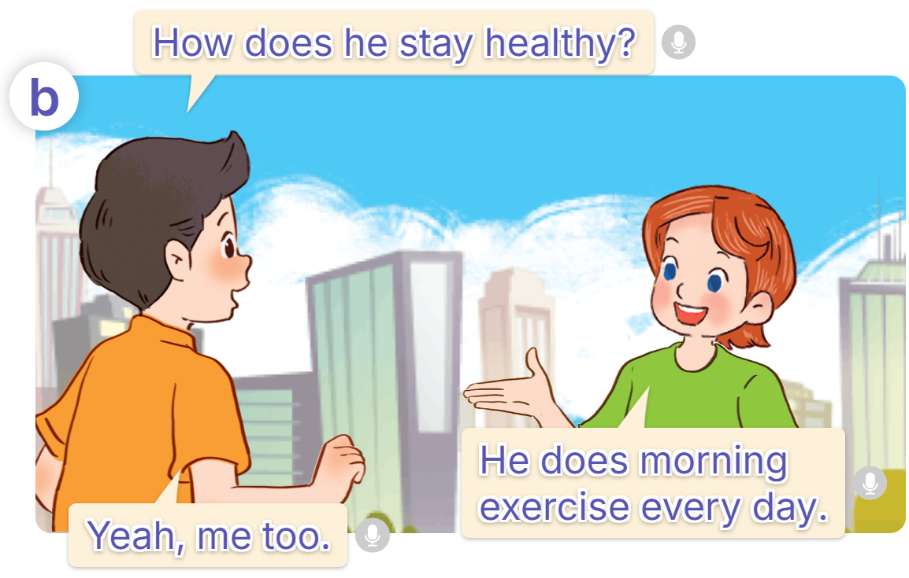
Listen and read
MsPham
0936082789

Slide 27
Look and read
MsPham
0936082789

Slide 28
Structure
Cách hỏi và trả lời ai đó giữ gìn sức khỏe như thế nào:
How does he / she stay healthy?
He / She + ______________.
(hoạt động)
MsPham
0936082789
Các hoạt động theo sau chủ ngữ là He/She thì động từ phải thêm
s/es
https://www.facebook.com/msphampowerpoint

Slide 29
Structure
Cách thêm s/es sau động từ
eat healthy food
eats healthy food
drink a lot of water
drinks a lot of water
play sports
plays sports
stay healthy
stays healthy
do morning exercise
does morning exercise
go for a walk
goes for a walk
https://www.facebook.com/msphampowerpoint

Slide 30
3
Listen, point
and say
Ms.Pham
0936082789
Ms.Liên
0984090525

Slide 31
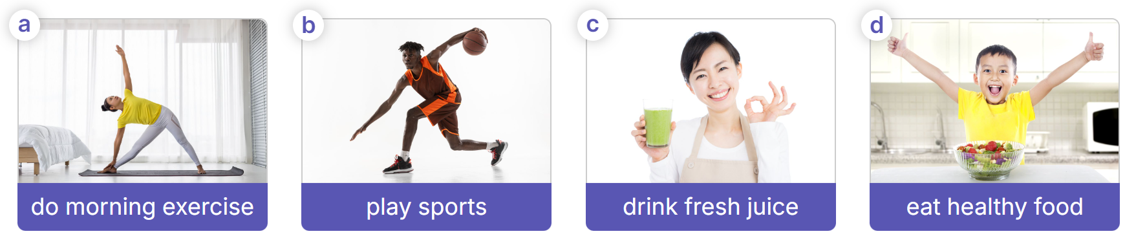
Listen, point and say
How does he / she stay healthy?
MsPham
0936082789
He / She ________.
https://www.facebook.com/msphampowerpoint

Slide 32
Listen, point and say
MsPham
0936082789
How does she stay healthy?
How does he / she stay healthy?
She does morning exercise?
He / She ________.
https://www.facebook.com/msphampowerpoint

Slide 33
Listen, point and say
MsPham
0936082789
How does he stay healthy?
How does he / she stay healthy?
He / She ________.
He plays sports.
https://www.facebook.com/msphampowerpoint

Slide 34
Listen, point and say
MsPham
0936082789
How does she stay healthy?
How does he / she stay healthy?
He / She ________.
She drinks fresh juice.
https://www.facebook.com/msphampowerpoint

Slide 35
Listen, point and say
MsPham
0936082789
How does he stay healthy?
How does he / she stay healthy?
He / She ________.
He eats healthy food.
https://www.facebook.com/msphampowerpoint

Slide 36
Listen, point and say
How does he / she stay healthy?
MsPham
0936082789
He / She ________.
https://www.facebook.com/msphampowerpoint

Slide 37
4
Let’s talk
Ms.Pham
0936082789
Ms.Liên
0984090525

Slide 38

Let’s talk
How does he / she stay healthy?
He / She ________.
do morning exercise
play sports
drink fresh juice
eat healthy food

Slide 39
5
Fun corner
and wrap-up
Ms.Pham
0936082789
Ms.Liên
0984090525

Slide 40





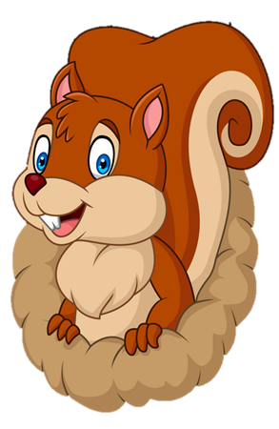
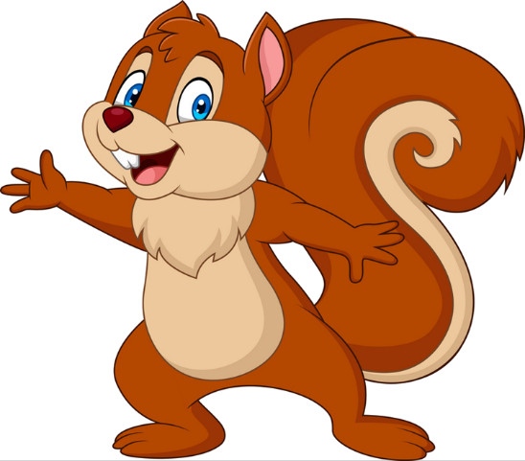
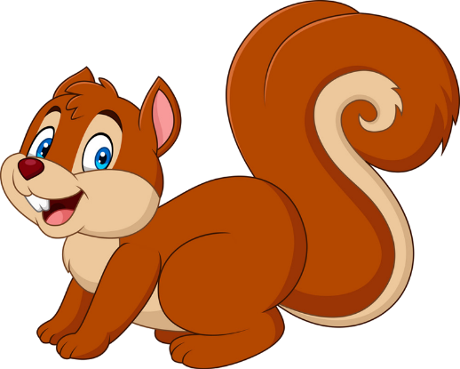
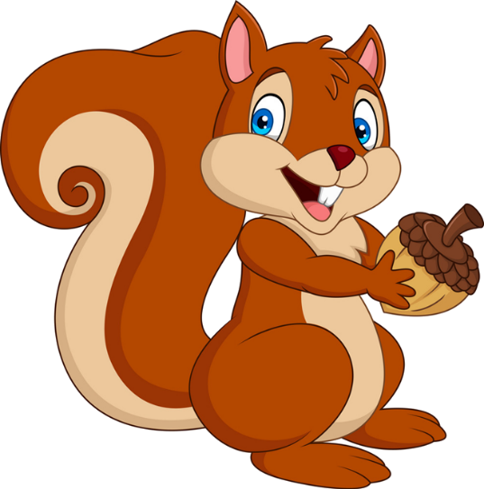


Slide 41



How does she stay healthy?
She ________.
does morning exercise
dos morning exercise

Slide 42
How does he stay healthy?
He ________.
play sports
plays sports

Slide 43
How does he stay healthy?
He ________.
eat healthy food
eats healthy food

Slide 44
How does she stay healthy?
She ________.
drinks fresh juice
drinkes fresh juice

Slide 45
How does he stay healthy?
He ________.
eates vegetables
eats vegetables

Slide 46
How does she stay healthy?
She ________.
drink a lot of water
drinks a lot of water

Slide 47


Good job!

Slide 48
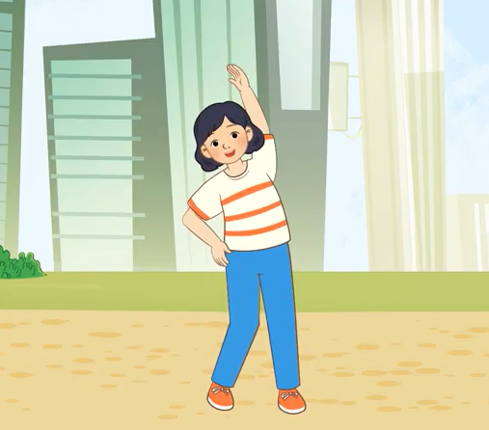

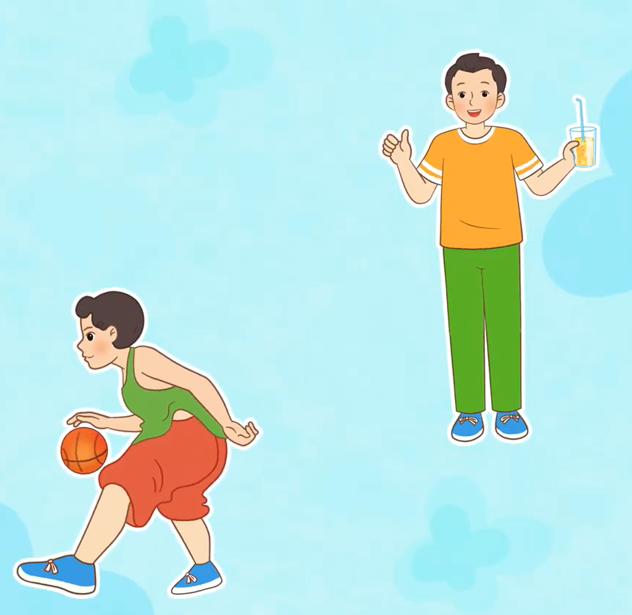
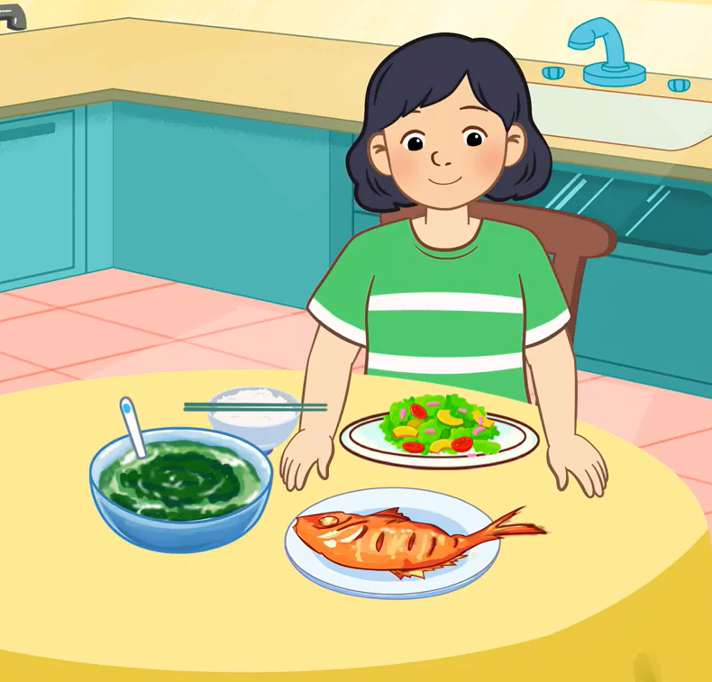
Review
drink a lot of water
How does he / she stay healthy?
He / She ________.
do morning exercise
eat vegetables
play sports
drink fresh juice
eat healthy food

Slide 49

THANK YOU

